Slide 1
Introduction to FHIR April 13-15, 2015 HIMSS15
Richard Ettema
Lead Consultant, AEGIS.net, Inc.
richard.ettema@aegis.net

Slide 2
This presentation
Can be downloaded at:
http://gforge.hl7.org/svn/fhir/trunk/presentations/2015-05 HIMSS/AEGIS - Intro to FHIR.pptx
(use “anonymous” and email address)
Is licensed for use under the Creative Commons, specifically:
Creative Commons Attribution 3.0 Unported License
(Do with it as you wish, so long as you give credit)

Slide 3
The Need
Share healthcare information electronically
HL7 v2 is nearly 30 years old
HL7 v3 and CDA more recent
Pressure to broaden scope of sharing
Across organizations, disciplines, even borders
Mobile & cloud-based applications
Faster – integration in days or weeks, not months
Notes:
Who

Slide 4
Genesis of FHIR
What would healthcare exchange look like if we started from scratch using modern approaches?
Web search for success markers led to RESTful based APIs
Example: Highrise API (https://github.com/37signals/highrise-api)
Drafted a healthcare exchange API based on this approach – http://hl7.org/fhir

Slide 5
FHIR Manifesto
Focus on Implementers
Target support for common scenarios
Leverage cross-industry web technologies
Require human readability as base level of interoperability
Make content freely available
Support multiple paradigms & architectures
Notes:
We don’t actually have a formal manifesto, but these are the principles we adhere to.

Slide 6
The acronym
F – Fast (to design & to implement)
Relative – No technology can make integration as fast as we’d like
H – Health
That’s why we’re here
I – Interoperable
Ditto
R – Resources
Building blocks – more on these next
Notes:
9:25

Slide 7

Resources
Defined Structured Data
The logical, common contents of the resource
Mapped to formal definitions/RIM & other formats
Syntax (XML and JSON)
Extensions
Local requirements, but everyone can use
Published and managed
Narrative
Human readable

Slide 8
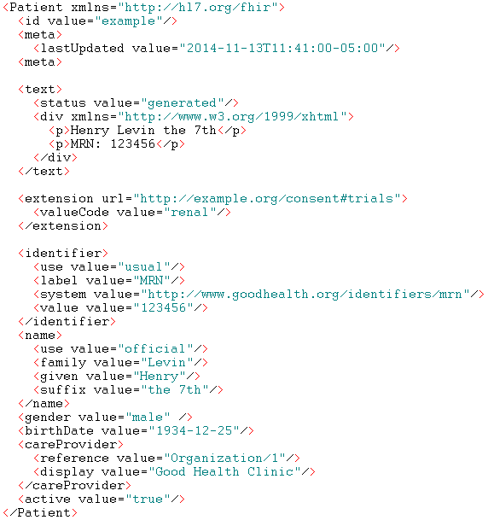
Identity & Metadata
Human Readable Summary
Extension with reference to its definition
Standard Data Content:
MRN
Name
Gender
Date of Birth
Provider

Slide 9
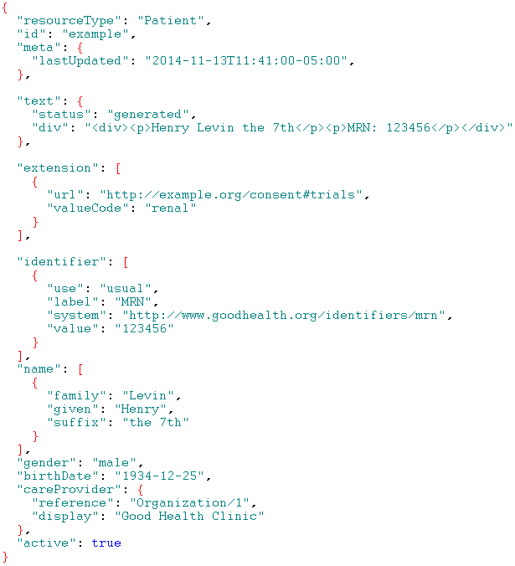
Identity & Metadata
Human Readable Summary
Extension with reference to its definition
Standard Data Content:
MRN
Name
Gender
Date of Birth
Provider

Slide 10
It’s all about the resources . . .
Building blocks…
Location
Related
Person
Patient
Diagnostic
Report
Practitioner

Slide 11
What is a Resource?
Examples
Non-examples
Administrative
Patient, Practitioner, Organization, Location, Coverage, Invoice
Clinical Concepts
Allergy, Condition, Family History, Care Plan
Infrastructure
Document, Message, Profile, Conformance*
Gender
Too small
Electronic Health Record
Too big
Blood Pressure
Too specific
Intervention
Too broad

Slide 12
Conformance*
There’s a resource for documenting conformance to FHIR
Can be used for:
Stating how a specific system instance behaves
Defining how a software system is capable of behaving (including configuration options)
Identifying a desired set of behavior
To declare themselves “FHIR Conformant”, a system must publish a Conformance instance

Slide 13

Human Readable
CDA taught HL7 a very important lesson
Even if the computers don’t understand 99% of what you’re sending, that’s ok if they can properly render it to a human clinician
This doesn’t just hold for documents – important for messages, services, etc.
In FHIR, every resource is required to have a human-readable expression
Notes:
Even when you think your target will understand all the encoded data, reality is data often gets shared beyond the originally intended context
Allow for exceptions for things like automated device readings, etc.

Slide 14
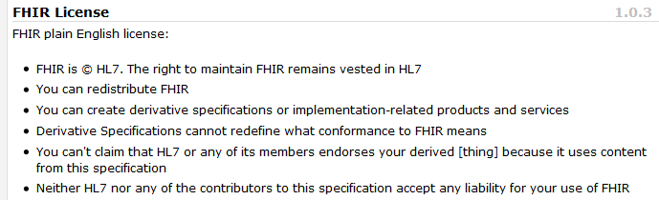
Freely available
Unencumbered – free for use, no membership required
http://hl7.org/fhir
Notes:
Was a bigger deal before HL7 decided to open up all IP
full legal text towards bottom of FHIR home page

Slide 15
Paradigms
FHIR supports 4 interoperability paradigms
REST
Documents
Messages
Services

Slide 16
REST
Simple, out-of-the-box interoperability
Leverage HTTP: GET, POST, etc.
Pre-defined operations
Create, Read, Update, Delete
Also: History, Read Version, Search, Updates, Validate, Conformance & Transaction
Works best where control resides on client side and trust relationship exists
REST
Notes:
URLs, parameters, etc. all defined
Choice of what operations to support
Behavior documented in conformance profile - mandatory

Slide 17
Documents
Similar to CDA
Collection of resources bound together
Root is a “Composition” resource
Just like CDA header
Sent as a Bundle (FHIR Resource)
One context
Can be signed, authenticated, etc.
Documents

Slide 18
Messages
Similar to v2 and v3 messaging
Also a collection of resources as a Bundle (FHIR Resource)
Allows request/response behavior for both request and response payloads
Event-driven
e.g. Send lab order, get back result
Can be asynchronous
Messages

Slide 19
Service Oriented Architecture (SOA)
Do whatever you like
(based on SOA principles)
Ultra complex workflows
Ultra simple workflows
Individual resources or collections (in Bundle, contained resources or other formats)
Use HTTP or use something else
Only constraint is that you’re passing around FHIR resources in some shape or manner
Services

Slide 20

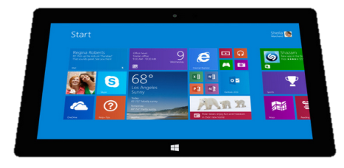
Regardless of paradigm the content is the same
Receive a lab result in a message…
FHIR
Repository
FHIR Message
FHIR Document
Lab System
REST
National
Exchange
…Package it in a discharge summary document

Slide 21

FHIR & other SDOs
IHE
Investigating use of FHIR for MHD (mobile XDS) and PDQm (mobile Patient Query)
http://www.ihe.net/uploadedFiles/Documents/ITI/IHE_ITI_Suppl_MHD.pdf
http://www.ihe.net/uploadedFiles/Documents/ITI/IHE_ITI_Suppl_PDQm.pdf
ONC
Structured Data Capture Initiative to facilitate the collection of supplemental EHR-derived data
http://wiki.siframework.org/Structured+Data+Capture+Initiative
Because FHIR is free and because of how it’s structured, use by other SDOs is certainly possible

Slide 22
Where can FHIR be used?
Classic in-institution interoperability
Back-end e-business systems (e.g. financial)
Regional Health Information Organizations (RHIO)
National EHR systems
Social Web (Health)
Mobile Applications
Near
Term

Slide 23
Recap: What does FHIR provide?
Resources (building blocks)
Extensions (part of the spec)
Methodology
Bundles, Profiles, Conformance
Syntax (XML, JSON)
Human readability
Support for multiple Paradigms
REST, Messaging, Documents, Services

Slide 24
FHIR Timeline (planned)
First Draft
1st
DSTU
~ 2nd
DSTU
~ 1st
Norm.
~ 2nd
Norm.
. . .
2011
2012
2013
2014
2015
2016
2017
2018
2019
2020

Slide 25
Demo and Discussion
AEGIS WildFHIR public site
Client → http://wildfhir.aegis.net/fhirgui
Server → http://wildfhir.aegis.net/fhir
Demonstrate
Patient Resource
Conformance Resource
FHIR Messaging – Clinical Decision Support Immunization Forecasting
In collaboration with the Immunization Information System (IIS) community; this is an example of creating a new FHIR Profile
http://openimmunizationsoftware.net/forecasting/forecasting.html

